Slide 1
Challenge 7 Infectious Swarm
Team members:
Shisheng wang
xiangtian yi
Ye xing
Yanlin zhou

Slide 2


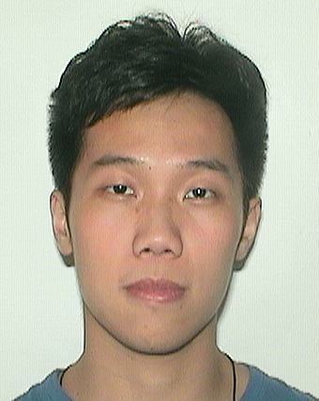

Presenter on this challenge
 | Xiangtian | Shisheng | Ye | Yanlin
Challenge 1 | Presenter
Challenge 2 |  | Presenter
Challenge 3 |  |  | Presenter
Challenge 4 |  |  |  | Presenter
Challenge 5 |  |  | Presenter
Challenge 6 |  | Presenter
Challenge 7 |  |  |  | Presenter
Challenge 8

Slide 3
TEAM WORK
Xiangtian | Shisheng | Ye | Yanlin
I helped implemented and test the circuit. | I helped setting up the xbee and modified the arduino code. | I engaged setting up the xbee from xctu and testing the arduino code. | I configured the circuit and engaged in testing the circuit.

Slide 4
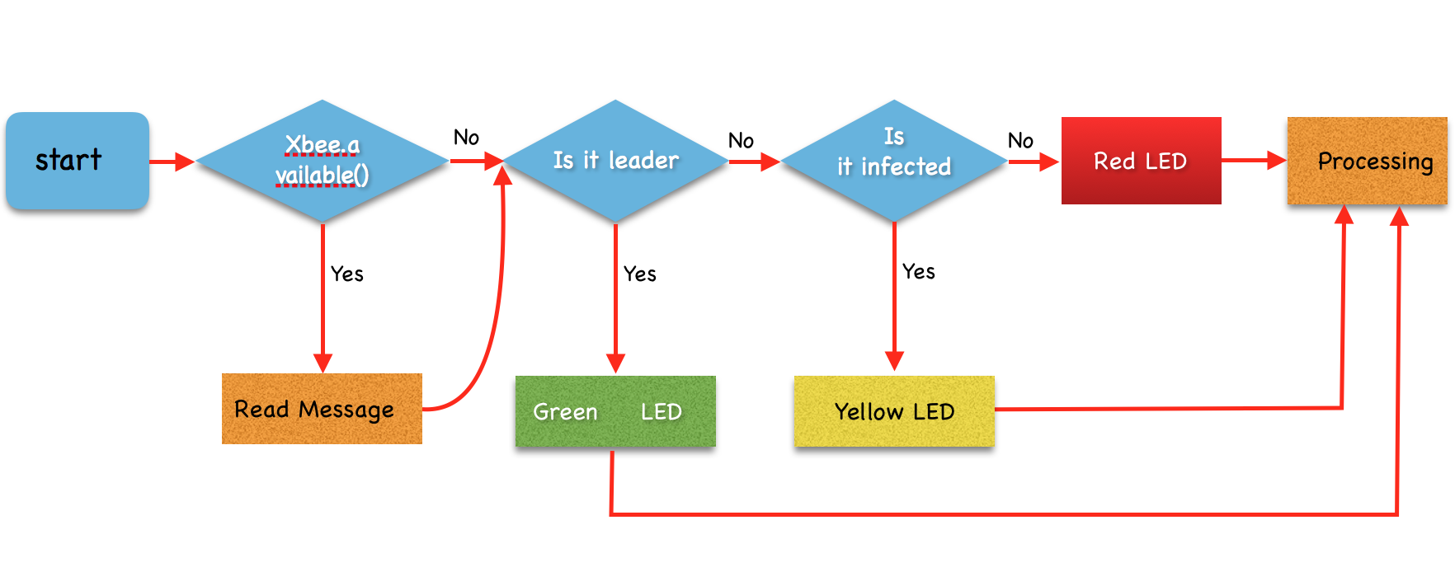
Software architecture

Slide 5
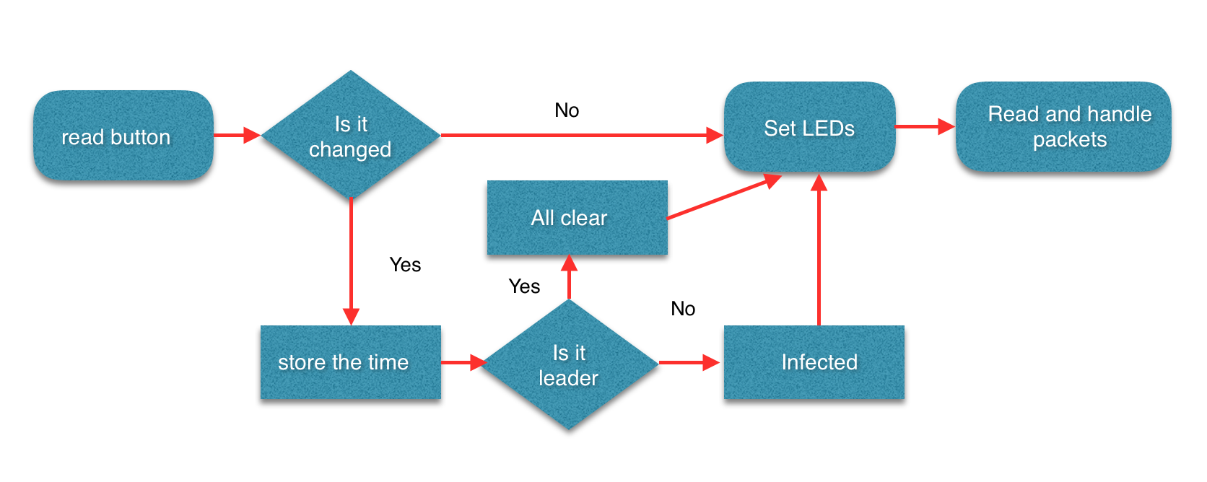
Step 1

Slide 6
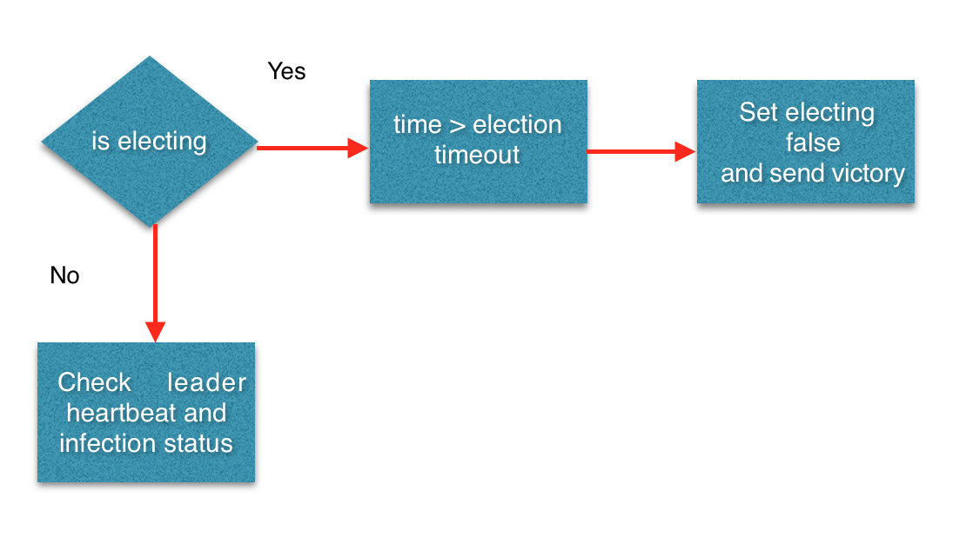
Step 2

Slide 7
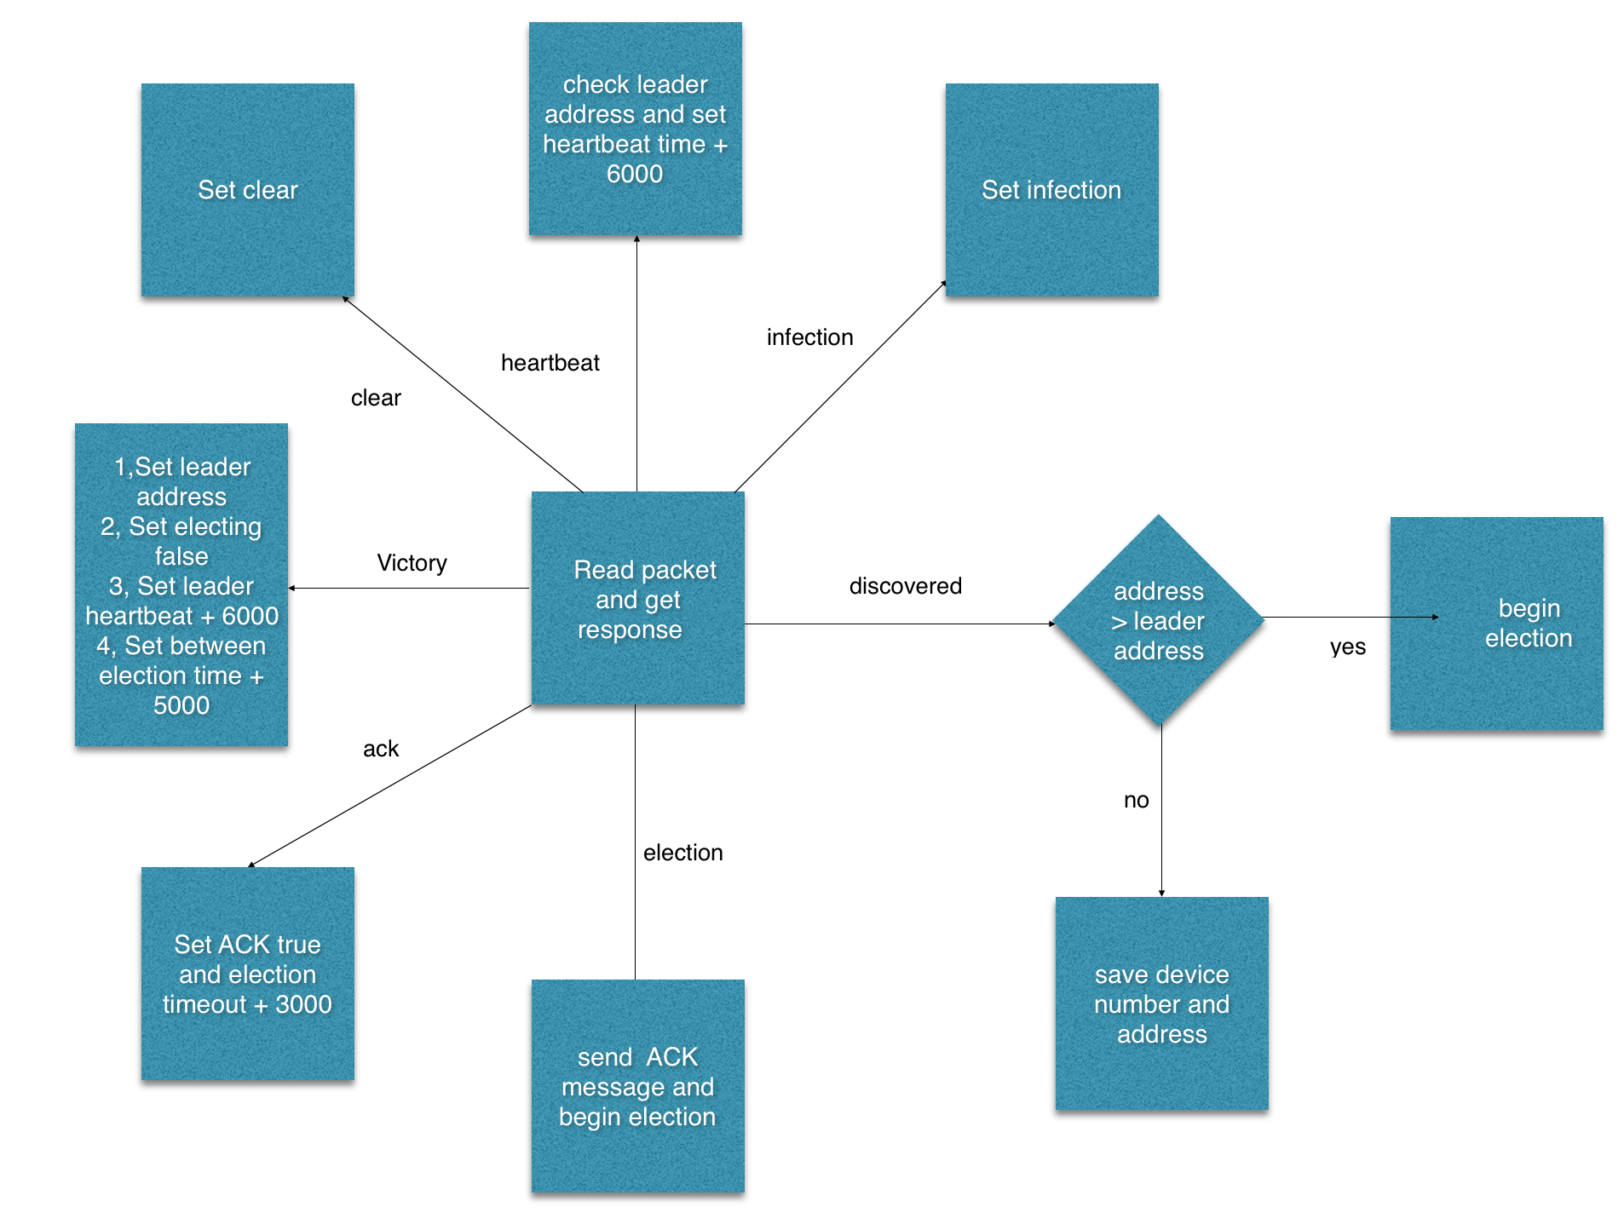
Read and handle

Slide 8
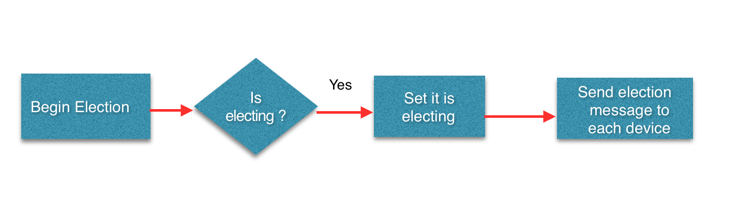
Begin election

Slide 9
Design decisions
Leader
Each device has an address, the device with the highest address is the leader.
A process initiates an election if it just recovered from failure or it notices that the leader has failed.
The new election would only occur while the new plugged-in device’s address is higher than the current leader’s.
Xbee Mode
We choose the API mode to implement the algorithm

Slide 10
Challenge & future improvement
Challenges:
Configure the Xbees, solve the communication problem.
Solving the problems when integrating all the components together.
Coding and testing the algorithm.
Improvement:
Lower latency
When leader re-plug-in to the network, the processing time can be reduced.

Slide 11
Thank you !

